Slide 1
Personal Finance Tracker
MONITOR Monthly income, expenses & savings
Author : kajal Patel
Tool used : tableau

Slide 2
Objective:
To create a visual dashboard that helps users:
Track income and expenses
Monitor savings trends
Understand spending patterns
Scope:
Monthly tracking
Categories: Groceries, training, entertainment, rent, education, Healthcare, etc.

Slide 3
Tools & Dataset
Tool Used: Tableau Public
Dataset:
Custom Excel Sheet with:
Date
Monthly Income
Monthly Expenses
Income Type
Category
Cash flow status
Savings, etc.

Slide 4
Visuals Created
Pie Chart: Expense Breakdown by Category
Bar Chart: Monthly Spending per Category
Line Chart: Savings Trend
KPI Cards: Income, Expense, Savings

Slide 5
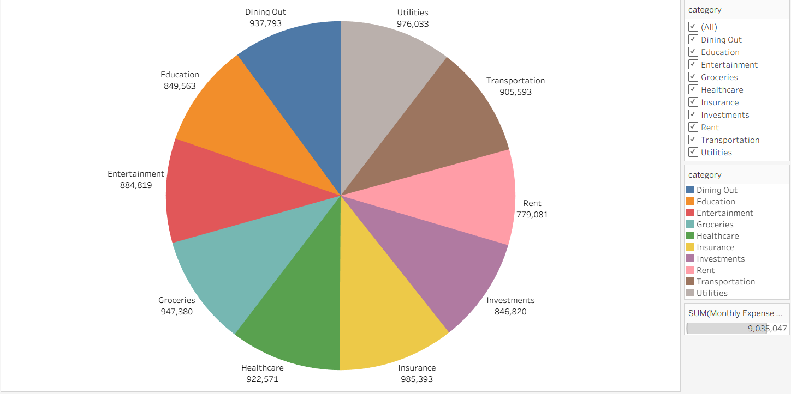
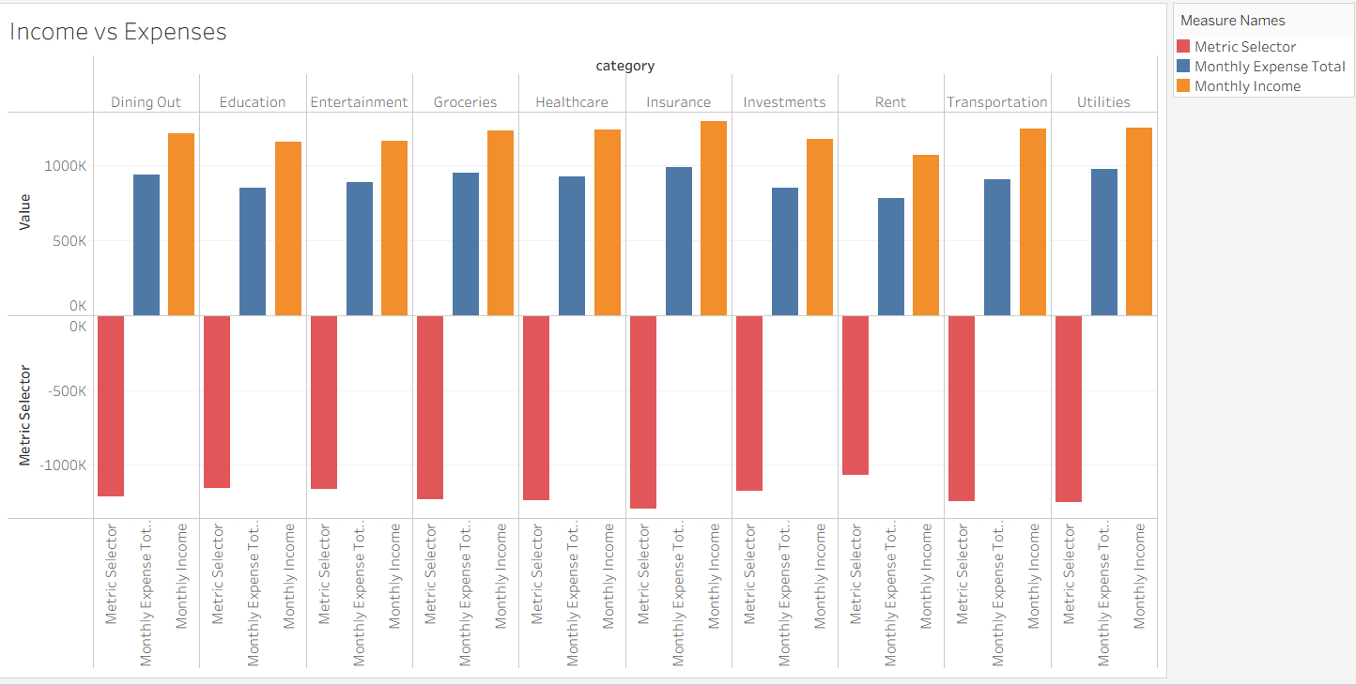
PIE CHART
BAR CHART

Slide 6
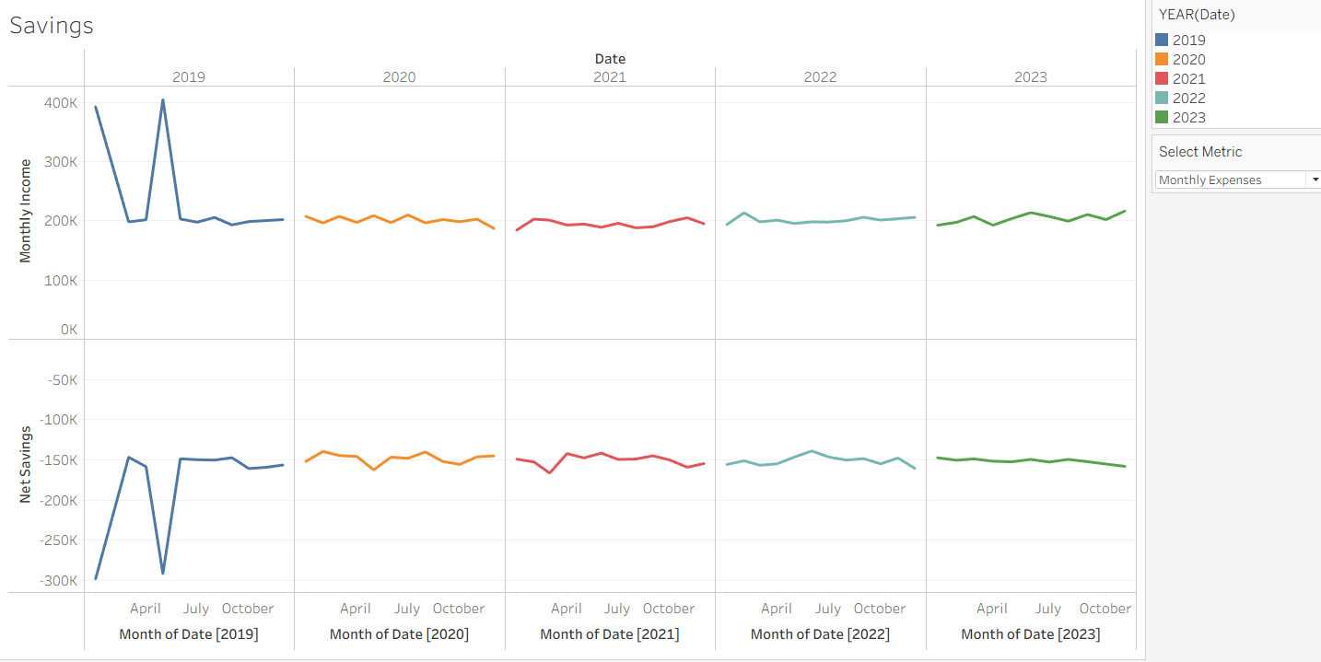
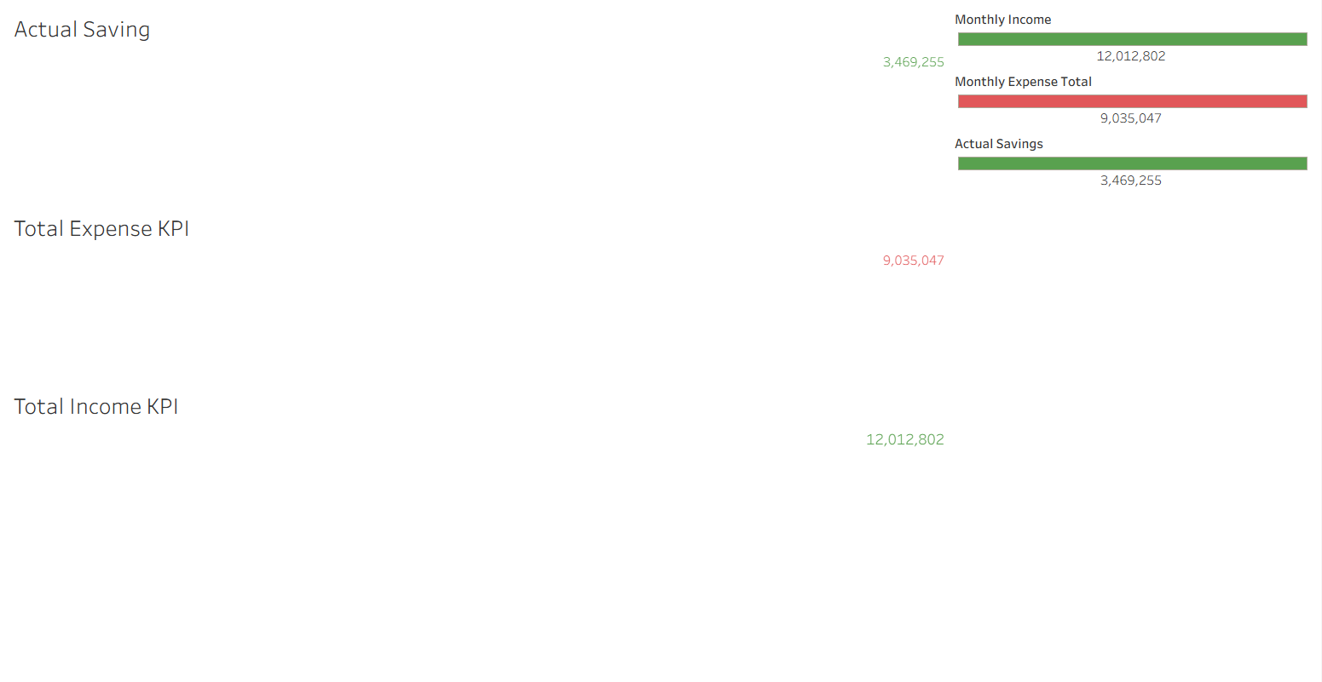
LINE CHART
KPI CARD

Slide 7
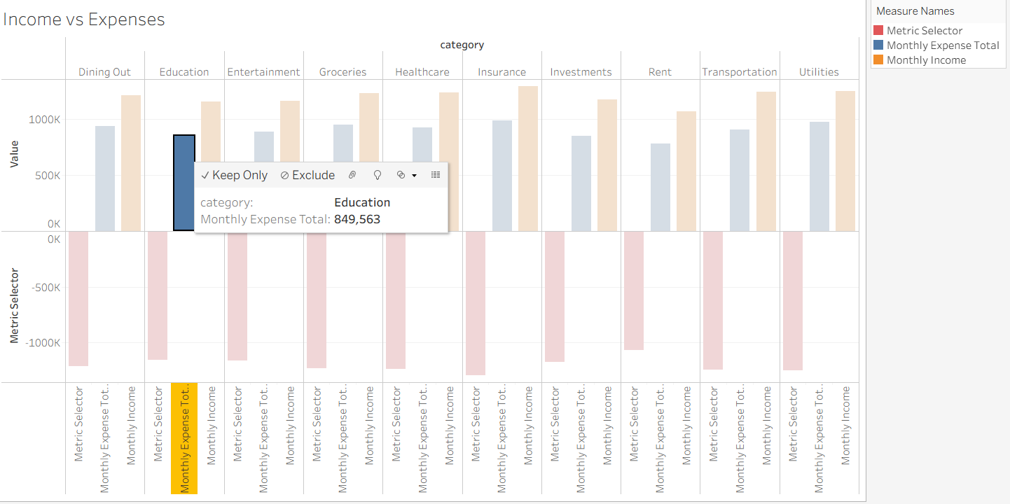
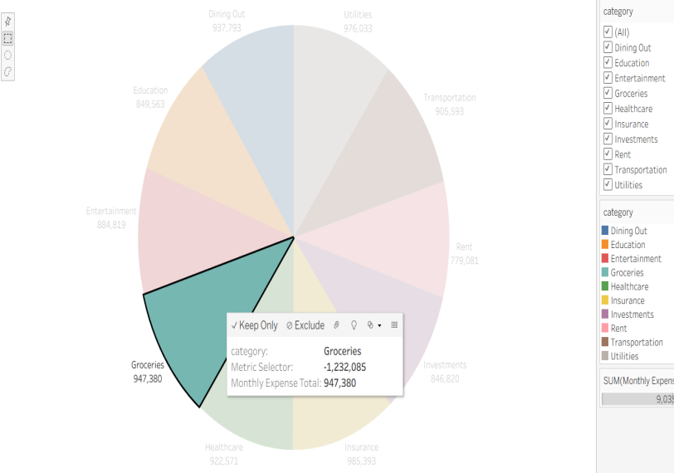
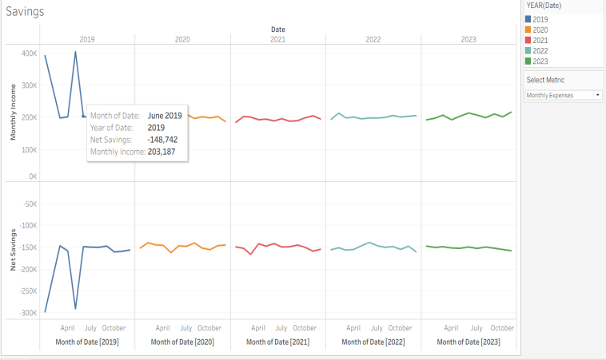
Filters and Parameters
Filters:
By Month
By Category
Parameters:
Select view: Income / Expense / Savings
Dynamic updates for KPIs & graphs

Slide 8
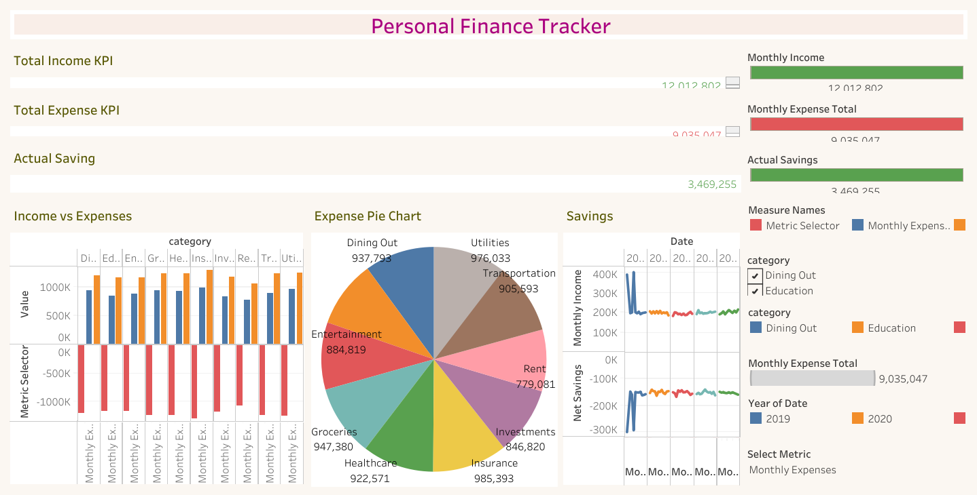
DASHBOARD

Slide 9

Key Analysis & Insights
💡 High Spending Habits:
More than 75% of income is spent — leaving just 25% for savings. Expense control is needed.
📉 Low Savings Efficiency:
Despite high income, actual savings are relatively low, indicating poor financial discipline.
📈 Top 3 Spending Categories:
Insurance, Utilities, and Dining Out consume the largest portions.
These three alone account for nearly 1/3rd of total expenses.
🛑 Discretionary Expenses Are High:
Dining Out and Entertainment together make up ₹1.8M — significant reduction potential.
⚖️ Balance Needed Between Needs & Wants:
Essentials (Groceries, Healthcare, Rent) are necessary, but optional categories can be optimized.
📉 Savings Can Be Boosted:
Cutting 10–15% from non-essential categories can improve overall savings by ₹500K–₹1M monthly
.
🎯 Actionable Recommendation:
Set category-wise monthly limits, and prioritize savings before discretionary spending.

Slide 10
Challenges Faced & Learnings
Challenges:
Learning Tableau from scratch
Managing calculated fields
Designing interactive dashboards
Learnings:
Built skills in data visualization
Understood personal spending habits better
Learned to create a complete data analysis pipeline

Slide 11
CONCLUSION
Successfully created a visual personal finance track.
Identified savings gaps and expense-heavy areas.
Ready to expand this tool for full-year budgeting.
Link to Tableau Public Dashboard:
https://public.tableau.com/views/PersonalFinanceTrackerProject1/PersonalFinanceTracker?:language=en-US&:sid=&:redirect=auth&:display_count=n&:origin=viz_share_link

Slide 12

THANK YOU !

